Slide 1
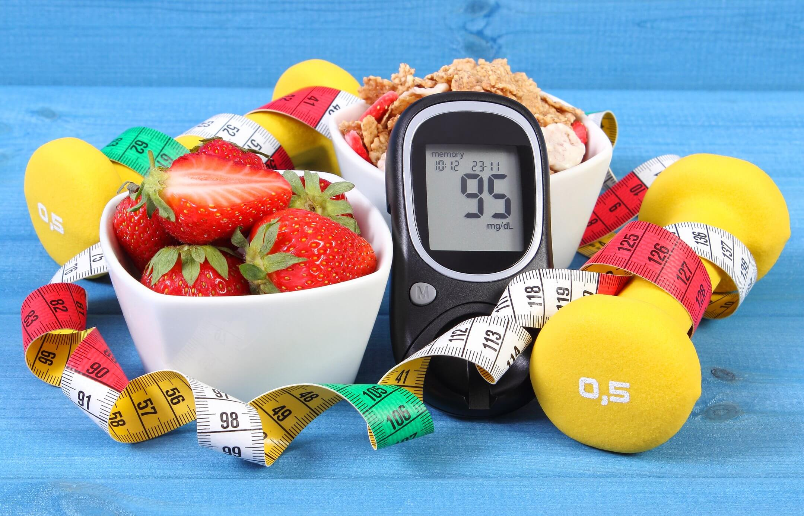
Using Random Forest to Classify Diabetes in women above age 21.

Slide 2
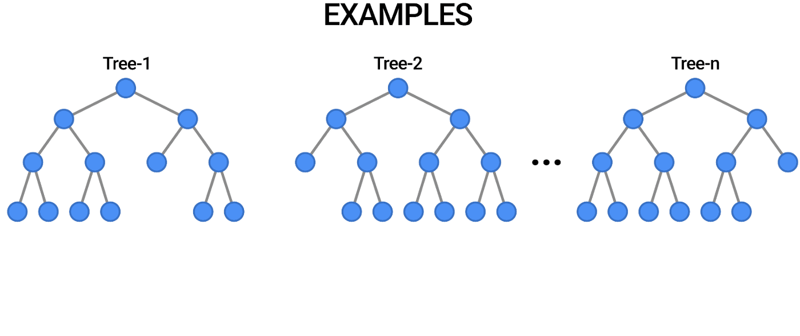
Random Forest
Ensembles of Decision Trees.
Decrease correlation between trees and reduce variability.
There are of types, Classification trees and Regression trees.

Slide 3
Advantages and Disadvantages
Advantages
More efficient than a single decision tree.
Tends to overfit less than Decision Trees.
Versatile, it can be used for Classification and Regression problems.
Easy to use.
Disadvantages
Overfitting may affect the overall Forest, it then needs Hyperparameter Tuning, which can slow down processing speed and consume time.

Slide 4
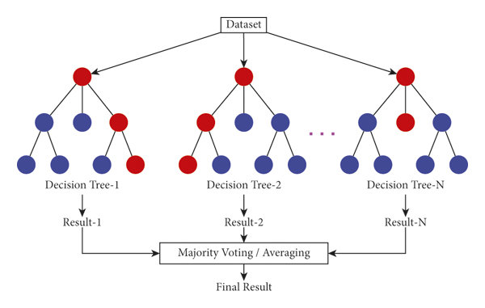
Bootstrap Aggregation
Build Multiple trees (Forest)
Evaluate a query across each tree
After each tree casts its own independent vote.
The commonly seen label will be the right label

Slide 5
Ensemble method - Bagging
Out-of-Bag data
Bootstrap Dataset ( After Sampling with Replacement)
Original Dataset
Chest Pain | Good Blood Circ. | Blocked Arteries | Weight | Heart Disease
No | No | No | 125 | No
Yes | Yes | Yes | 180 | Yes
Yes | Yes | No | 210 | No
Yes | No | Yes | 167 | No
Chest Pain | Good Blood Circ. | Blocked Arteries | Weight | Heart Disease
Yes | Yes | Yes | 180 | Yes
No | No | No | 125 | No
Yes | No | Yes | 167 | No
Yes | No | Yes | 167 | No
Bagging allows us to introduce variability in the rows and columns, which helps our model to generalize better…

Slide 6
Model Accuracy
Chest Pain | Good Blood Circ. | Blocked Arteries | Weight | Heart Disease
Yes | Yes | No | 210 | No
No
The Out-of-Bag Sample is run through all the decision trees to measure the accuracy of the model. The label with the most votes wins. This tree correctly labelled it as ‘No’.

Slide 7
Validating our Model….
Chest Pain | Good Blood Circ. | Blocked Arteries | Weight | Heart Disease
Yes | No | No | 160
Heart Disease Yes No 1 0

Slide 8
Predicting new Data: Sample Tree 1
No
Chest Pain | Good Blood Circ. | Blocked Arteries | Weight | Heart Disease
Yes | No | No | 160

Slide 9
Sample Tree 2
Yes
Chest Pain | Good Blood Circ. | Blocked Arteries | Weight | Heart Disease
Yes | No | No | 160

Slide 10
Sample Tree 3
No
Chest Pain | Good Blood Circ. | Blocked Arteries | Weight | Heart Disease
Yes | No | No | 160

Slide 11
Sample Tree 4
Yes
Chest Pain | Good Blood Circ. | Blocked Arteries | Weight | Heart Disease
Yes | No | No | 160

Slide 12
Sample Tree 5
No
Chest Pain | Good Blood Circ. | Blocked Arteries | Weight | Heart Disease
Yes | No | No | 160

Slide 13
Sample Tree 6
No
Chest Pain | Good Blood Circ. | Blocked Arteries | Weight | Heart Disease
Yes | No | No | 160

Slide 14
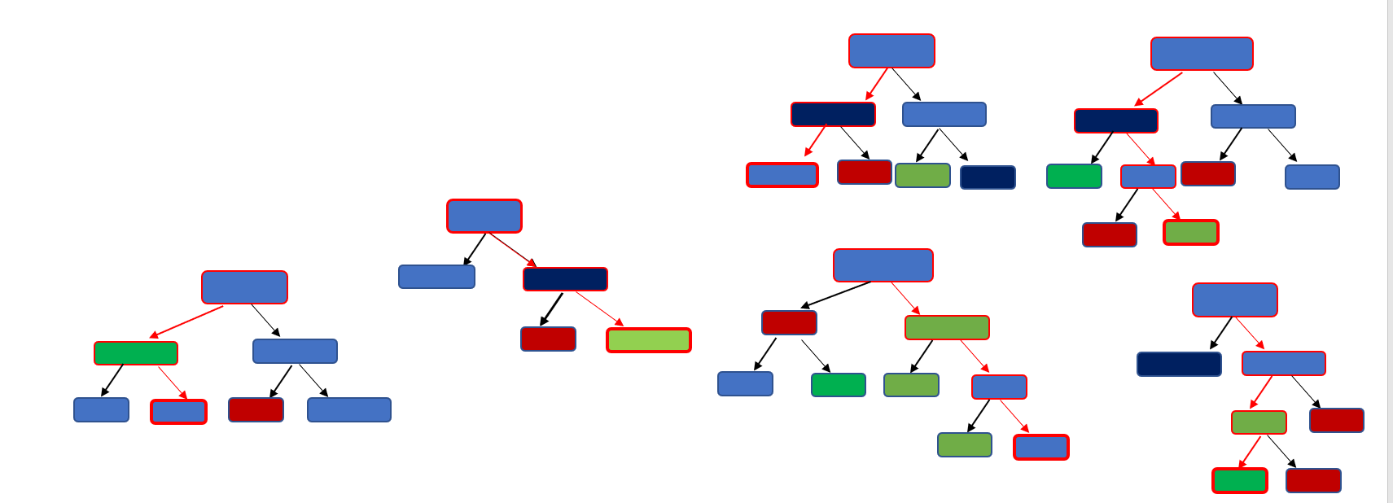
Results
Based on majority vote, the model predicts this patient doesn’t have heart disease
Chest Pain | Good Blood Circ. | Blocked Arteries | Weight | Heart Disease
Yes | No | No | 160 | NO
Heart Disease Yes No 2 4

Slide 15
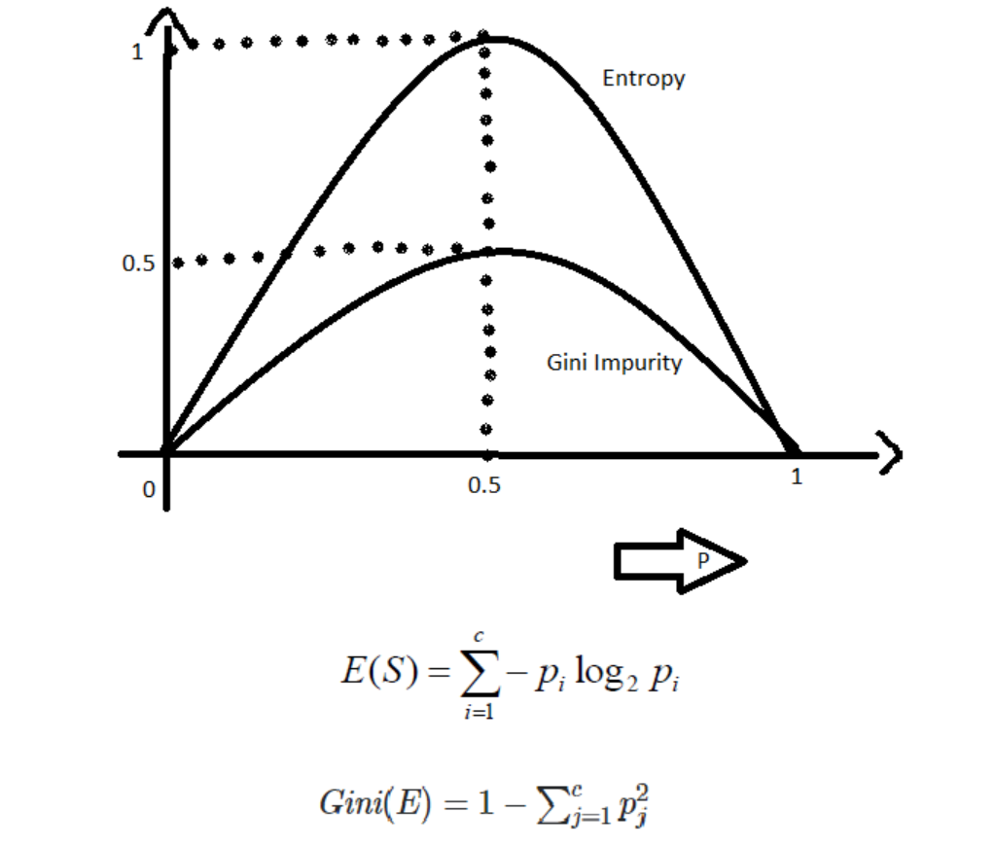
Classification Problem in Random Forest
Gini is more efficient in terms of entropy when comparing computing power.
Gini impurity is used for this report

Slide 16
DATA
Context
This dataset is originally from the National Institute of Diabetes and Digestive and Kidney Diseases. The objective is to predict based on diagnostic measurements whether a patient has diabetes.
Content
Several constraints were placed on the selection of these instances from a larger database. In particular, all patients here are females at least 21 years old of Pima Indian heritage.
Pregnancies: Number of times pregnant
Glucose: Plasma glucose concentration a 2 hours in an oral glucose tolerance test
Blood-Pressure: Diastolic blood pressure (mm Hg)
Skin-Thickness: Triceps skin fold thickness (mm)
Insulin: 2-Hour serum insulin (mu U/ml)
BMI: Body mass index (weight in kg/(height in m)^2)
Diabetes-Pedigree-Function: Diabetes pedigree function
Age: Age (years)
Outcome: Class variable (0 or 1)

Slide 17
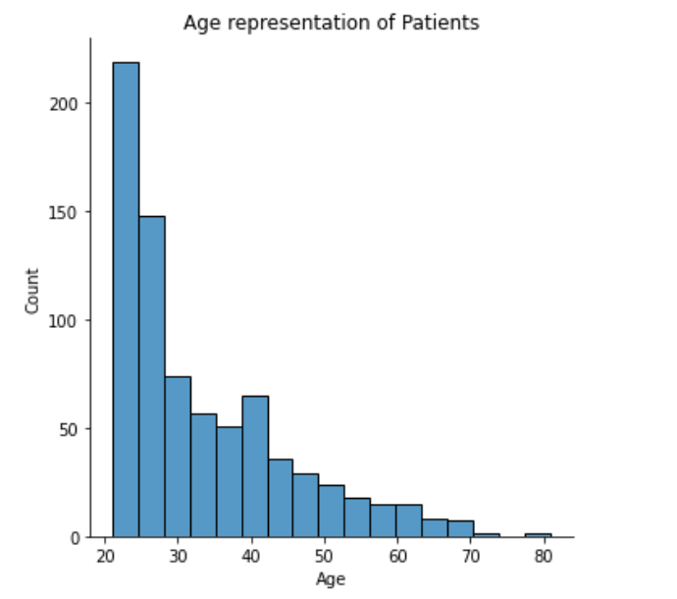
Data Visualization
More Than 30% of the data lies between age 20-30

Slide 18
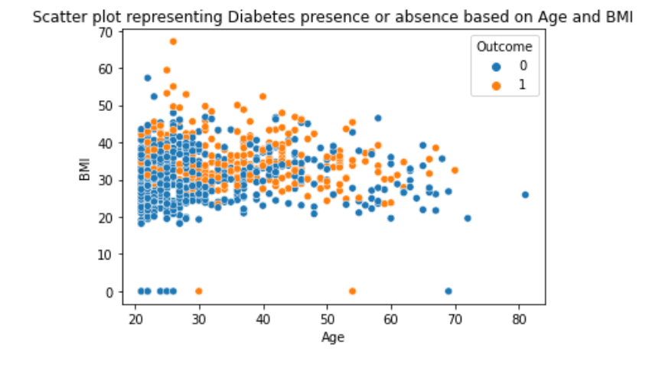
Outcome 0 represents Absence of diabetes
Outcome 1 represents Presence of diabetes
There’s no clear correlation between the age and BMI as regards the presence of Diabetes

Slide 19
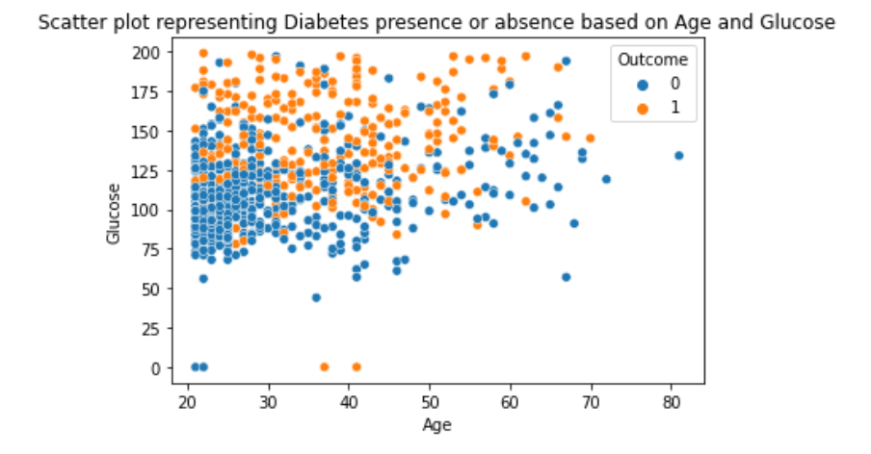
Outcome 0 represents Absence of diabetes
Outcome 1 represents Presence of diabetes
There’s no clear correlation between the age and BMI as regards the presence of Diabetes

Slide 20
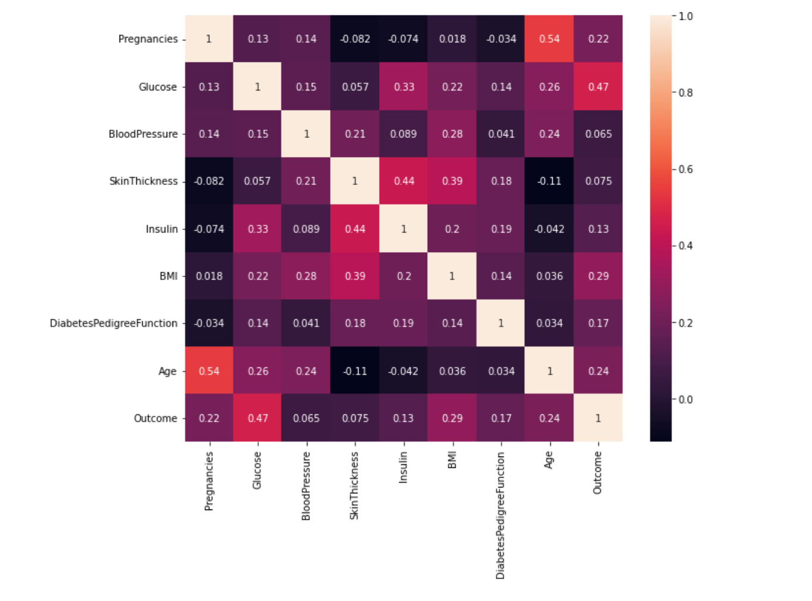
The correlation matrix shows that
Age has 54% correlation to Pregnancies, this means the older a person, the more children they are likely to have.
Glucose has 47% correlation to the possibility of having diabetes.

Slide 21
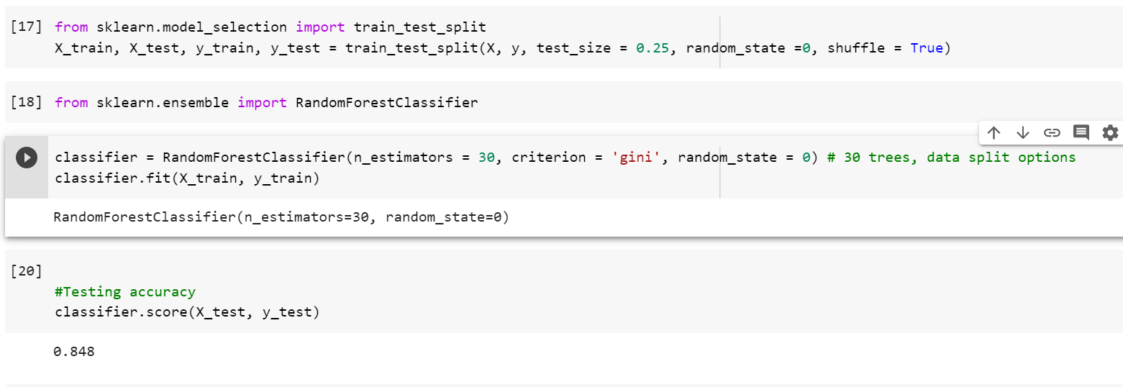
Splitting the Data and Random Forest Classification

Slide 22
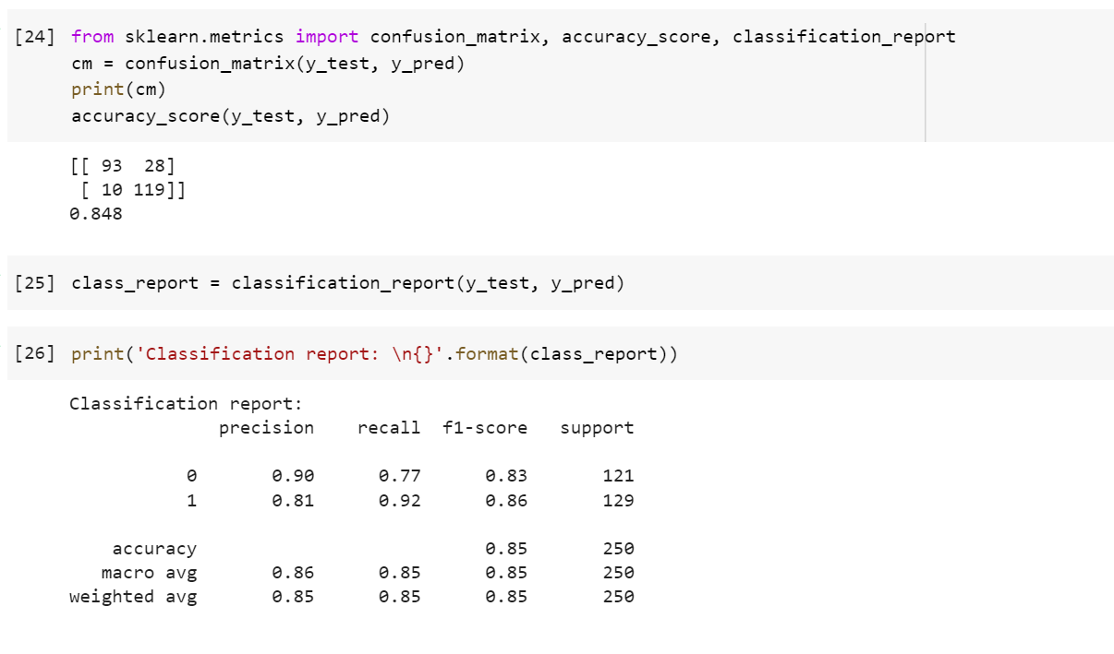
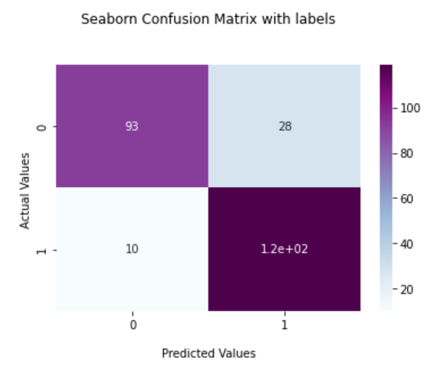
Classification Report
Confusion Matrix
TN
FP
FN
TP

Slide 23
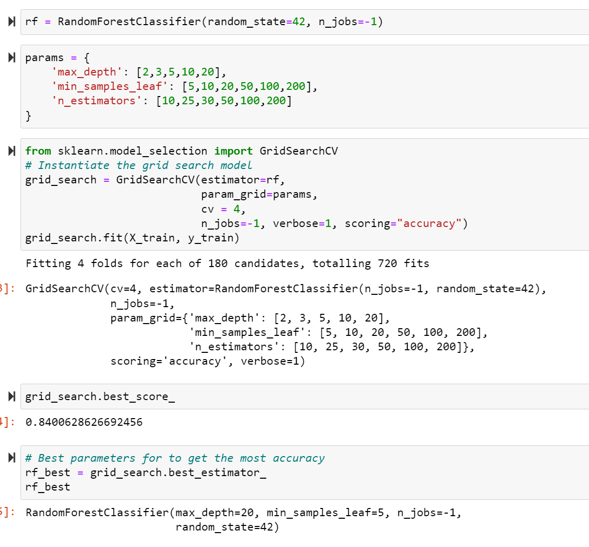
Hyper-Parameter Tuning

Slide 24
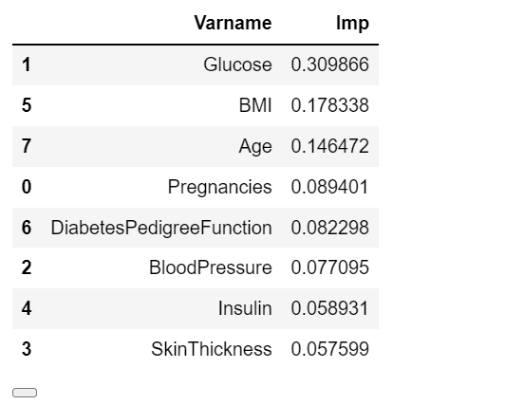
Feature Importance
Based on relevance
Glucose Level
Patient’s BMI
Age of Patient.

Slide 25
Conclusion
F1 – 0.85
Age has 54% correlation to Pregnancies
Glucose level has a 47% correlation to the presence of diabetes in a patient
A patients glucose level, BMI and Age are the most considerable factors in determining diabetes in a patient.

Slide 26
REFERENCES
ML | Gini Impurity and Entropy in Decision Tree() Available online [Accessed: 22/03/2022]
https://www.geeksforgeeks.org/gini-impurity-and-entropy-in-decision-tree-ml/
Steven S. Skiena (2017) The Data Science Manual. Switzerland: Springer Nature
StatQuest with Josh Starmer (2018) Random Forest Part 1, Random Forest [Video]. Available online [Accessed: 20/03/2022]
Edureka (2020) Random Forest Explained Random Forest [Video]. Available online [Accessed: 22/03/2022]
Kaggle DIABETES DATASET, Available online [Accessed: 22/03/2022]

